Slide 1
Comparing Fast Food Restaurant Density to Median Household Income
Group 5
Michael Battaglia, Sarah Gearardo, Deep Ghosh,
Julie Magro, Melissa Nondorf

Slide 2
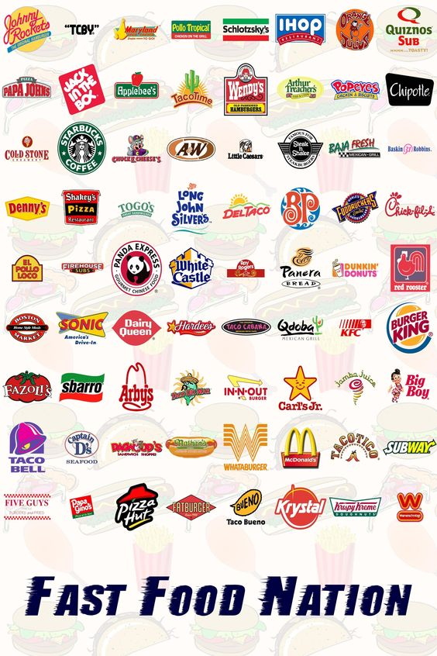

Our Hypothesis
H₀: There is no relation between the density of fast food restaurants and median household income
H_{a}: There is a negative correlation between the density of fast food restaurants and median household income
Notes:
In the US, fast food restaurants are generally thought of as "cheap food" and are often associated with low-income areas in people's minds. We chose to use a machine learning linear regression analysis to investigate if there is a significant correlation between median income and density of fast food restaurants by zip code.

Slide 3

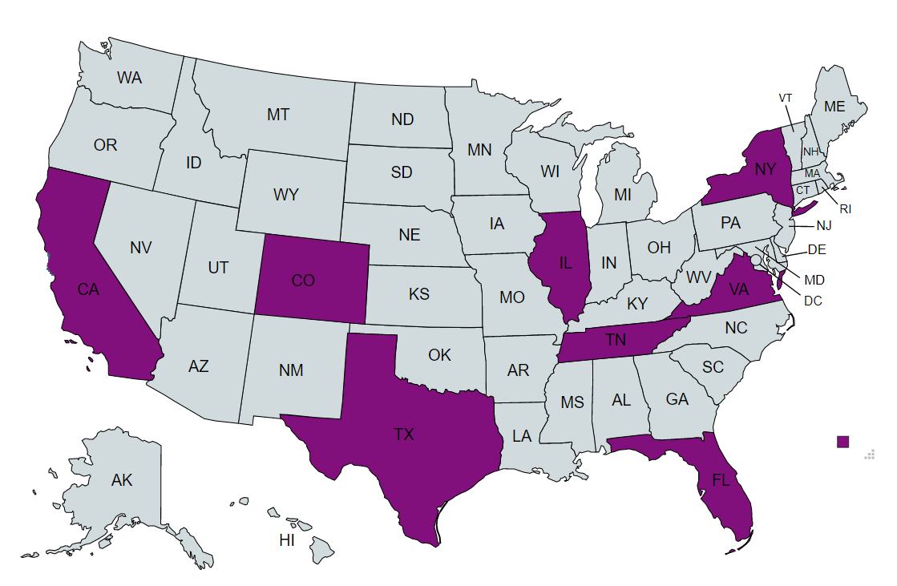

Data
Census Data on US Household Income Statistics for 2011-2015
Restaurant locations scraped from Yelp
Notes:
We chose a subset of eight states (CA, CO, FL, IL, NY, TN, TX, and VA) to run our analysis on in order to keep the scope of the project manageable, given the project's time constraints.
According to the US Census Bureau, USPS Zip codes are not physically- or politically-defined features but a collection of mail delivery routes. In other words, the only thing that distinguishes one zip code from another is the post office that services that area. Despite this, zip codes often represent a kind of proxy for socio-economic status.

Slide 4
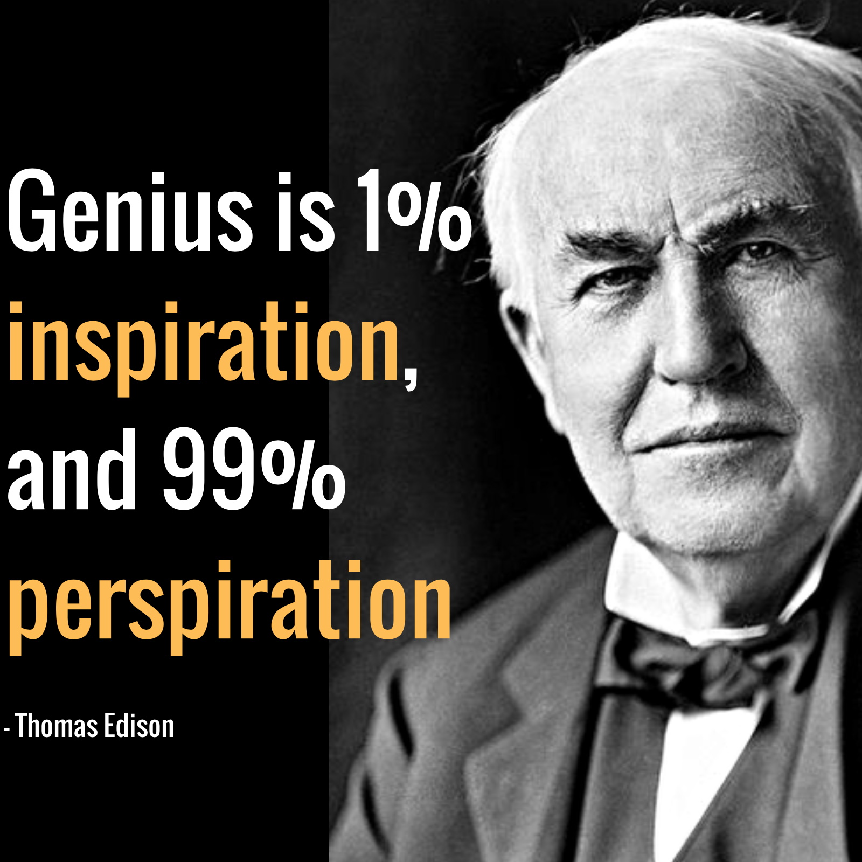
Much like Edison’s quote, our project felt like 1% analysis and 99% ETL.
Notes:
Find data sources and agree on a topic and hypotheses - easy
Extract data: easy for HHI, difficult for Yelp API (not user-friendly)
Transform data: seemed easy but ended up having to go back and make additional changes multiple times
Load: Easiest of the three parts

Slide 5


Household Income Data
Began with: 32,526 rows and 19 columns
Dropped unwanted columns, duplicate zips, null values, removed DC and PR, formatted zip codes to have leading zeros
Left with: 14,664 rows and 6 columns
Yelp API Results
Started off with: 27,606 results in individual state files
“Globbed” the 8 csv files together: 27,458 results*
Dropped duplicates: 13,248 results

Slide 6



Ready to analyze, right? WRONG
Notes:
Joined the Yelp and HH Income tables together and dropped the address, latitude, longitude, and standard deviation columns because they were no longer needed.
In deciding which of the two zip code columns to drop, discovered that the the HH Income file included 1,164 rows with null values for zip code. Since we dropped all null values during initial cleaning of that dataset, we assume that this must indicate that some restaurants were located in zip code areas that did not appear in the HH Income dataset. We changed our join from FULL to INNER to remove these null values, which further reduced our dataset to 12,084.

Slide 7
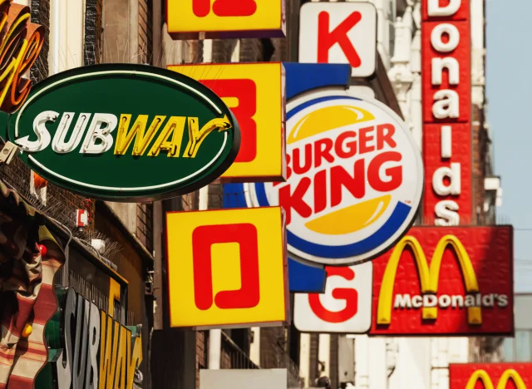
Analysis
Round 1: simple linear regression with all 12,804 data points
Round 2: simple linear regression, removing the cluster of results at the $300k limit
Round 3: multiple linear regression with all 12,804 data points but only using data for the top 5 most popular “types” of fast food restaurant
Notes:
Audience participation time: Can anyone guess what the most common type of food returned from the Yelp API scrape? Hotdogs!

Slide 8
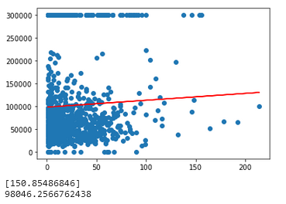
Results
Notes:
Add the other two graphs
The initial analysis showed a weak but positive correlation between our independent variable - density of fast food restaurants - and our dependent variable - median income. As this went against our hypothesis of a negative correlation between the two, we decided to run the numbers are few more times with further adjustments to the data to see if those changes made any difference.
Removing the potential outliers of extremely high median incomes clustered at the $300k line resulted in……
Parsing out the five most popular food types and running MLR resulted in……

Slide 9
Recommendations
Next steps would include,
Incorporate the findings into the machine learning model to predict income levels for a zip based on the number of fast food restaurants.
Work to understand ways to work towards a greater R-squared value in the model to increase its accuracy.

Slide 10
